Slide 1




LiON Gun Description, Operation and Safety
December 1, 2016
BOSS Training Series
Basic Operation and Safety School
SK080528

Slide 2
LiON Gun Description: Features, Advantages and Benefits
BOSS Training Series
Basic Operation and Safety School

Slide 3

LiON Gun Key Features
High-strength planetary gear drive powered by brushless DC electric motor
  Current model targets 3/8” to 3/4” bolts, torque 25-250 ft-lbs
Electronic control and setup via push-button menu.
Heads-Up LCD display.
Ergonomic lightweight hand-held design with pistol-grip and trigger activation.
Portable tool powered by rechargeable extended-life 18V lithium ion battery.
Standard square-drive with dual-reaction spline.
Integrated data acquisition and export capability.

Slide 4
LiON Gun Advantages & Benefits
Speed, Power and Precision meet Portability and Safety
Advantage | Benefit
High-strength gear box driven by brushless motor delivers faster and smoother torque application vs. manual clicker wrenches, impact wrench's and other tightening tools. | Faster, more accurate and more repeatable in achieving torque requirements on all bolted joints in the specified torque range, accuracy ± 5%.
Electronic control with push-button menu provides users with greater control and resolution in field configuration and settings. | Eliminates potential human error from interpolation of torque tables, simplifies set-up, easily adjust settings in the field to optimize bolting quality and safety.
Heads-up LCD display clearly presents all torque parameters, easily viewed and monitored by the user during operation. | Display allows operator to carefully monitor and control torque, heads-up display position allows user to safely view the screen while applying torque.
Ergonomic and lightweight pistol-grip design allows easy one-hand tool operation with single finger application of torque. | Improves controlled application of torque while reducing operator strain; results in higher quality, productivity and more reliable bolted joints.
Rechargeable 18V battery provides immediate source of power, typically lasts 2X longer than other LiON batteries, allows greater portability & mobility vs. other tools. | Long lasting batteries mean fewer interruptions, typically lasts for hundreds of bolts, portable tool avoids entanglement and safety concerns vs. hoses or cables.
Standard square drive with dual spline design allows flexible configuration for traditional bolting with standard sockets or bolting with the HYTORC washer system. | One tool may be used for a wide variety of bolting applications, defraying the cost, use of the HYTORC washer system significantly improves safety.
Data recording allows the user to automatically collect a complete data profile of job torque parameters for all events, data easily transferred to a PC | Allows job data to be easily analyzed as part of the quality assurance and to be stored as a part of the permeant job record.

Slide 5
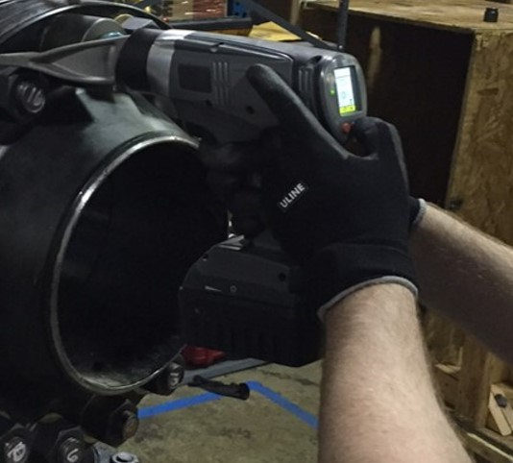
Ergonomic Design Features
Single-finger activation
Simply squeeze the trigger to apply torque
Heads-Up LCD Display
User can safely view the screen during operation
Molded pistol grip
Handle design conforms to hand, providing a more secure grip
Push-Button Setup
For easy setup and operation
Overall tool design is lightweight and balanced allowing one-hand positioning and operation
Allows one-hand operation when configured for the HYTORC Washer
Requires two-hand operation when configured for traditional bolting with a reaction arm, the tool requires the operator to use two hands as a safety precaution, forcing the user to keep the second hand away from the reaction area by pushing a button on the rear panel
Audible feedback
Beeper sounds on completion of operation
Quiet Operation
Noise level is typically less than 80dB
Configured for Traditional Bolting with Reaction Arm

Slide 6

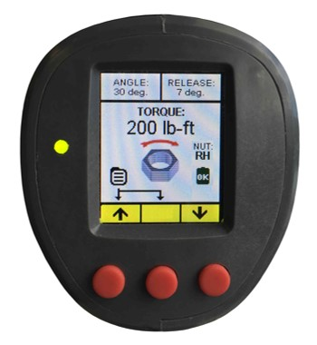
Tool Features
The LiON Battery Gun is a rugged industrial torque tool designed for precise application of torque using electronic control features packaged in an ergonomic hand-held tool.
Square drive compatible
with standard sockets
Cooling vents
Brushless DC Motor
and cooling fans
Reaction spline
Beeper
Control Panel
Planetary gear box
Trigger
USB Micro Port
Pistol grip handle
Directional switch
Battery Lock Button
Battery Test Button and Charge Indicator
18V Rechargeable and Interchangeable Li-Ion Battery
Push-button
control

Slide 7
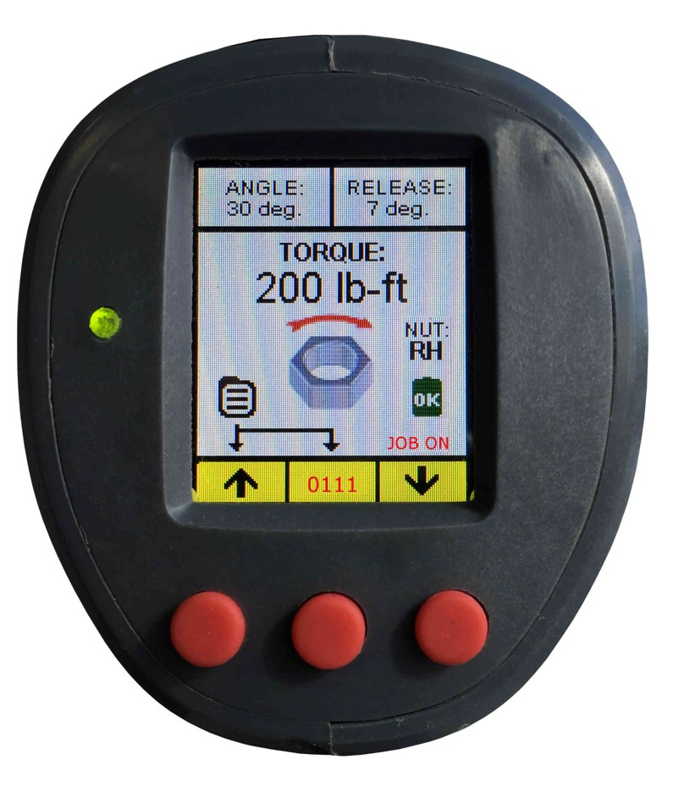
Control Panel Features
LiON tool has (3) push-buttons and a simple graphical LCD Display Screen
on the rear to control all functions, menus and features.
Angle
Release (Angle)
Rotational Direction Arrow
Torque, Angle, Release
Setting
Fastener Setting
Status LED
Rotating Nut Icon
Battery Charge Indicator
(green charged battery, turns red with low voltage)
Menu Shortcut Key
Job On Indicator
Shown when recording job data
Increase Value
Decrease Value
Job Number
Shown when recording job data
Left Button
Right Button
Center Button

Slide 8
Control Panel Features
The LiON tool provides primary control via the Control Panel on the rear.
LCD Screen
Primary Control Features
Press Any Button to Power-On Tool (auto off after 5 min)
Left Button Increases Value
Right Button Decreases Value
Screen Features; Torque, Angle, Release, Direction, Battery Status, Fastener Type, Data Record Indicator
Push and hold center button to cycle; TORQUE, ANGLE and RELEASE
Hold 2 Left Buttons to display main and sub-menu options
ADMIN
SET ADMIN CODE
SET LOCKOUT MODE
SET CLOCK
U/L TORQUE LIMIT
CALIBRATE GUN
MAIN MENU
↓ | → | ↑
SYSTEM
SYSTEM INFO
DISPLAY ROTATION
BEEPER
MAIN MENU
↓ | → | ↑
JOB DATA
START/STOP RECORDING
DATA HISTORY
GENERATE CSV FILE
MAIN MENU
↓ | → | ↑
OPERATION
JOB PROFILES
FASTENER TYPE
OUTPUT UNITS
ANGLE DELAY
MAIN MENU
↓ | → | ↑
MAIN MENU
OPERATION
JOB DATA
SYSTEM
ADMIN
EXIT MENU
POWER OFF
↓ | → | ↑
Push-buttons
(See Menu Descriptions in Operations Section)
Advantages | Benefit
Extremely clear LCD display, provides setting summary at a glance. | Reduces potential human error associated with torque table interpretation and tool setup – improves quality of bolted joints.
Simple push-button control of all major functions. | Reduces time in setting torque and related options, increases productivity.
LCD digital display allows setting torque, angle, etc. to a greater resolution, provides extremely tight control over bolting. | Greater accuracy and consistency in achieving torque requirements on all bolted joints, Accuracy ± 5%
LCD menu structure allows customized setup best suited for each application, also allows the administrator to restrict functions as desired. | Menu driven control supports higher performance and higher quality in the bolting work operation.

Slide 9
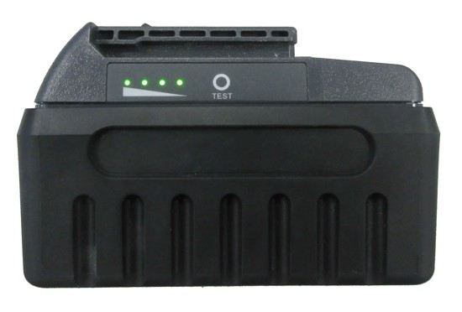
Battery Features
The LiON tool is supplied with 1 long-life 18V rechargeable and interchangeable
lithium-ion battery with charge indicator provided on battery and screen.
18V Extended Life Battery
1 Battery Supplied, additional batteries ordered separately
Integrated Test Button and Charge Indicator
Advantage | Benefit
Supplied with one (1) rechargeable 4.1 Ah -18V lithium-ion batteries that provide a run-time 2X that of standard lithium-ion batteries. | Long lasting batteries mean fewer interruptions of work operations, typically lasts for hundreds of bolts.
Test button and charge indicator on the battery and LCD screen indicator alert the operator when it’s time to recharge or switch to the spare battery. | Allows operator to monitor the battery discharge, charge the spare battery so that it is ready when needed or the recharge the battery to avoid down time.
Battery and gun are portable eliminating the need for cords or hoses associated with hydraulic, pneumatic or electric cord powered technology. | Improves safety by eliminating potential tripping hazards with hoses/cables.
Immediate source of power after battery is charged. | Significantly reduces setup time.

Slide 10
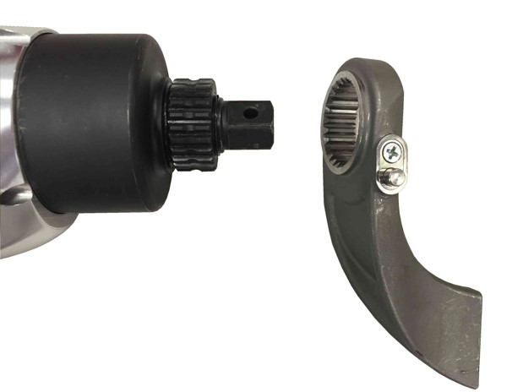
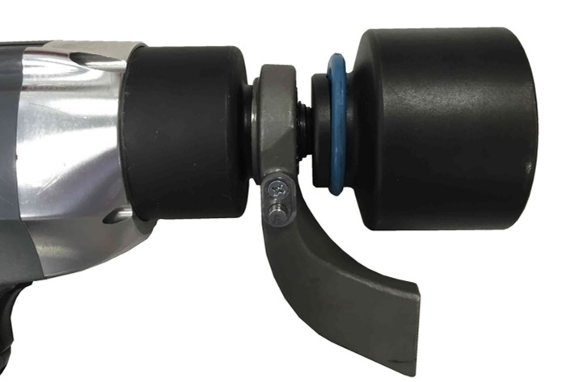
Traditional Bolting Configuration
The LiON tool may be quickly configured for traditional bolting with
the push-button reaction arm and standard sockets.
Push-Button Reaction Arm
Standard Sockets
Advantage | Benefit
One-piece reaction arm is designed for quick installation on the LiON tool with an integrated Push-Button – this eliminates the need for loose screws and wrenches to secure the reaction arm. | Push-button installation saves significant time in tool configuration, reduces down time from missing screws or Allen wrenches.
Standard square-drive provides compatibility with standard sockets. | The standard square drive allows use and reuse of standard sockets; often providing saving on socket expense.

Slide 11
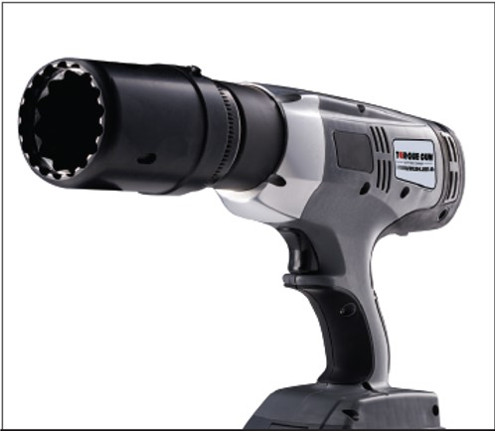
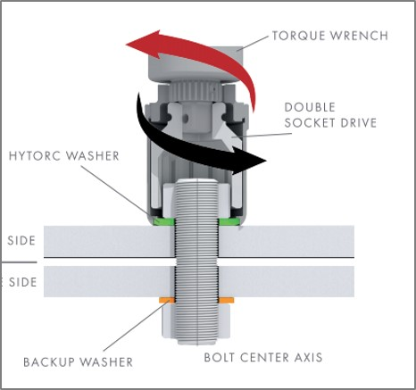
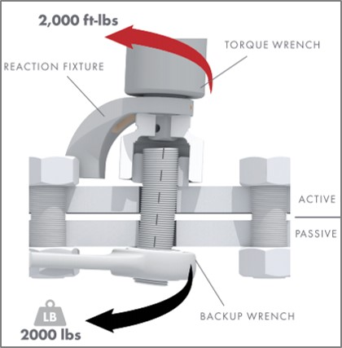
HYTORC Washer Configuration
The LiON Tool may be quickly configured for “Reaction-Arm Free” bolting
with the HYTORC Washer and HYTORC Backup Washer.
LiON Tool with HYTORC Washer Driver
LiON Tool with HYTORC Washer Driver eliminates the reaction arm pinch points and improves axial alignment of tool over the nut
Conventional reaction arm with pinch point and bending forces are eliminated with the HYTORC Washer/Back Washer
Pinch Point
Bending
Forces in
Joint
Advantage | Benefit
Easily configured for use with the HYTORC Washer as a reaction point – eliminating the need for a reaction arm. | Elimination of reaction arms means elimination of dangerous pinch points and significantly improved safety.
The HYTORC Backup Washer grips against the back surface - eliminating the need for back wrenches. | Elimination of backup wrenches means faster and safer operation.
Significantly improves axial alignment of the tool over the nut and bolt application – eliminating bending forces from reaction arms. | Improves efficiency of torque transfer to bolted joints and reduces damage to bolts such as stripped threads or galling; results in less rework.

Slide 12
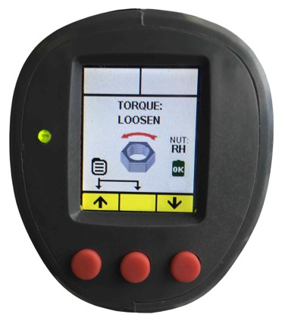
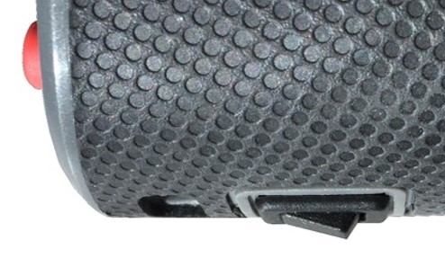
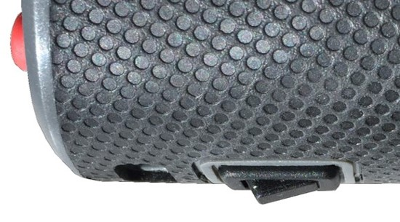
Directional Control
The LiON Tool has a toggle switch beneath the barrel to easily change drive direction from tighten to loosen by pressing the switch - Screen also Changes from TORQUE to LOOSEN.
TIGHTEN
LOOSEN
T
L
T
L
Tighten
Loosen
Advantage | Benefit
Toggle-switch directional control allows the operator to easily change to tighten or loosen nuts without the need to remove drives or sockets. | Reduces setup time by allowing the operator to select tighten or loosen without reconfiguring the tool; significantly improving productivity.

Slide 13
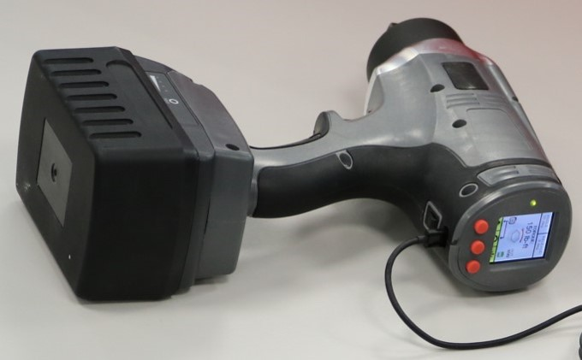
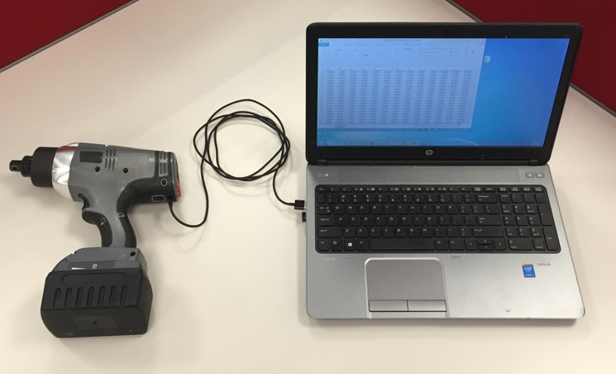
Data Recording
The LiON Tool can record and store torque data in the tool memory and when complete a CSV file can be downloaded with a complete record for the job; compatible with Excel, text & other formats.
USB Connection to tool
USB Connection to computer
Advantage | Benefit
The Lion tool can be used to automatically record torque parameters for all events. | Reduces the time and cost of automatically collecting data at the source, allowing data to be used for quality assurance and as a permeant job record.
Standard USB - PC connection to tool. | Use readily available USB cables, saves time and cost for downloading data
Plug-and-play file transfer to a PC. | Data may be easily transferred to a PC by simply connecting the cable.
File is automatically generated in a standard CSV file format | CSV format is imported in the PC as an Excel file (when Excel is installed on the PC) making it faster to analyze and share data.

Slide 14
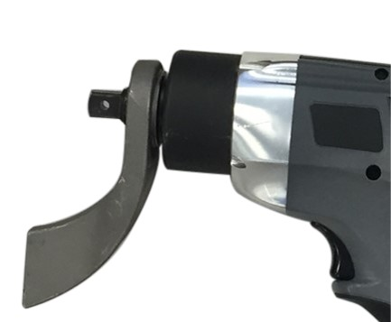

LiON Model Specifications
The 18V LION-250 Battery Gun is a an 18V power tool with maximum torque of 250 ft-lbs.
L
H
R
Shown with
Reaction Arm
Model | Torque Range | Drive | H | L | R | Speed | Final Torque Speed | Weight With Battery
18V LION-250 Battery Gun | 25-250 ft-lbs 34 – 340 Nm | ½” | 10.8” 27 cm | 10.2” 26 cm | 2.45” 6.2 cm | 9 RPM | 7 RPM | 6.9 lbs 3.1 kg

Slide 15
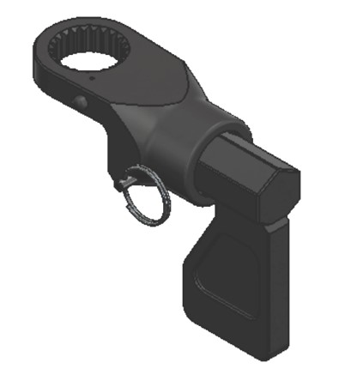
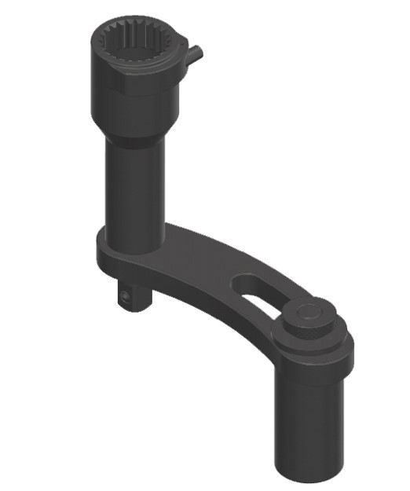
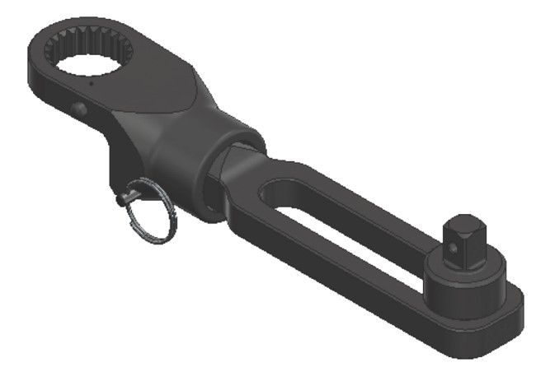
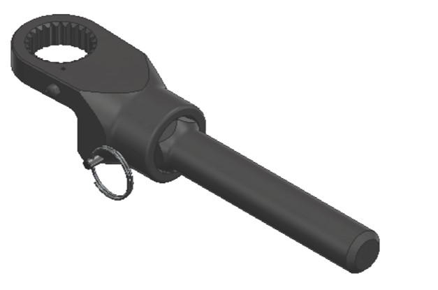
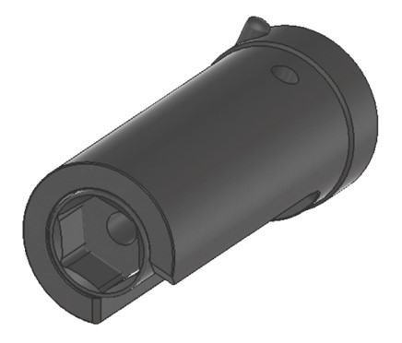
LiON Gun Accessories
Accessories allow the LiON tool to be adapted for a variety of applications.
Track Pad Reaction Fixture with socket
LION.25-HXA-TPF-DIM
Deep Well Reaction Fixture with adjustable right angle
LION.25-HXA-DW-DIM
Wheel Bolting Extension
Reaction Fixture
LION.25-WG-EXTRF-5
ALCO Arm Reaction Fixture
with adjustable extension bar
LION .25-HXA-ALCO
Barrel Lid Retainer
LION.25-RF-010-BD-ASM

Slide 16
LiON Gun Basic Operation
BOSS Training Series
Basic Operation and Safety School

Slide 17
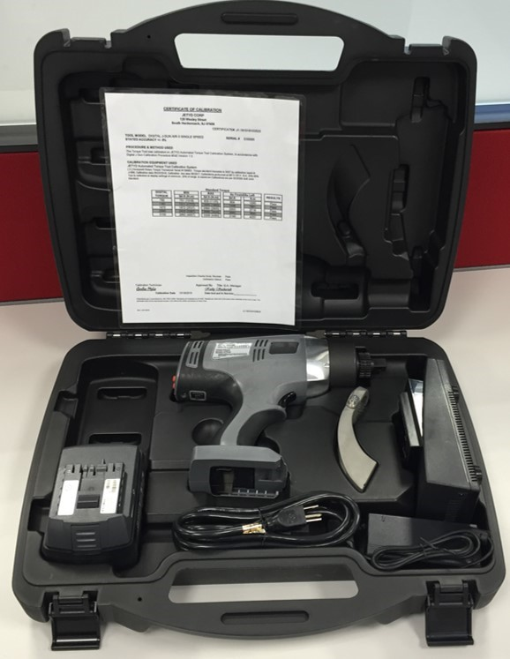
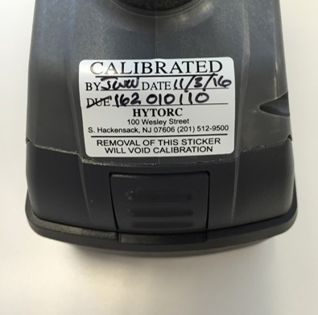
Care and Handling
Inspect Tools Upon Receipt, Safely Store Tools when not in use.
Inspect all components as they are received; if damaged report any sign of damage to the shipper and do not use the tool.
Inspect the tool before each use; repair or replace any obviously worn or damaged parts.
Maintenance must be performed by a qualified technician.
Modifying any of the components invalidates the warranty.
HYTORC recommends tool recalibration annually. Check the calibration date on the tool. If more than a year has passed since last calibration, contact HYTORC for recalibration.
When not in use store all tool components in the plastic storage case.
Save all instructions and calibration reports in the storage case.
Check Calibration Sticker for Due Date
Store LiON Gun and components in the carrying case when not in use.

Slide 18
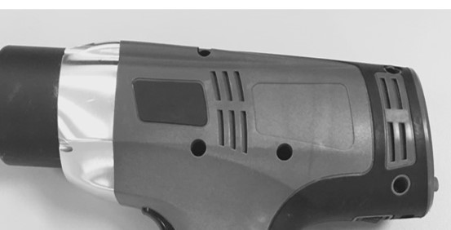
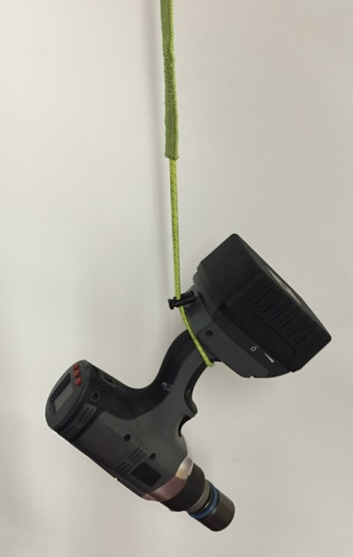
Environmental Considerations
The LiON Gun is a rugged industrial tool with an electric motor and electronic control.
The following environmental considerations will help maintain reliable tool operation.
Liquids/Humidity – The tool will withstand light splashing but should not be submerged or subjected to continuous rain or extreme humidity.
Temperature – The operating temperature of the tool should be less than150 deg. F.
Dust – All Cooling Vents should be kept clear of dust, dirt and debris to allow internal fans to maintain airflow to keep the motor and electronics within temperature limits, do not subject the tool to extreme dust environments that would clog the vents or do not cover the vents with your hand.
Explosive environments – The LiON tool and electronic components are not certified or approved for explosive environments or areas containing combustible chemical materials.
Do Not Drop – HYTORC recommends that the LiON tool not be dropped. Follow local procedures to secure the tool to protect from dropping.
Keep cooling vents clear
Secure the LiON Gun according to local practice to prevent damage from dropping.

Slide 19
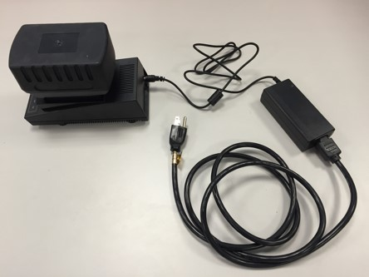
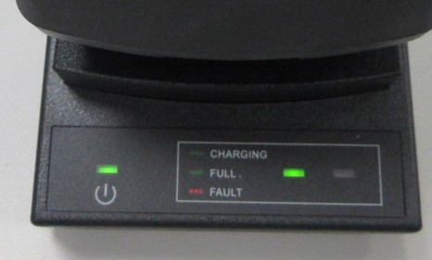
Charge Battery
The battery is quickly charged in approximately one hour.
Battery
Pack
Charging
Cable
Power Supply
Power Supply Requirements
The battery charger power supply can operate at 110V or 220V AC.
Note: Compatible 100V to 240V AC, 50/60 Hz.
The power supply cord is configured for North American outlets/plugs, other regions may require adapters.
Connecting
Connect the power charging cable into the charger cradle.
Plug the power supply cord into the appropriate AC outlet before inserting a battery pack.
Insert the battery pack by sliding it into the charger cradle and locking it in place.
Charging
POWER INDICATOR green when charger is plugged into AC outlet.
CHARGING INDICATOR is flashing green while battery is charging.
CHARGING INDICATOR is solid green when battery is fully charged.
FAULT INDICATOR is flashing red for battery fault not charging.
Battery is fully charged in approx. 1-hour.
Charging
Cradle
Power
Supply
Cord
Fault
Indicator
Power
Indicator
Charging
Indicator
Legend

Slide 20
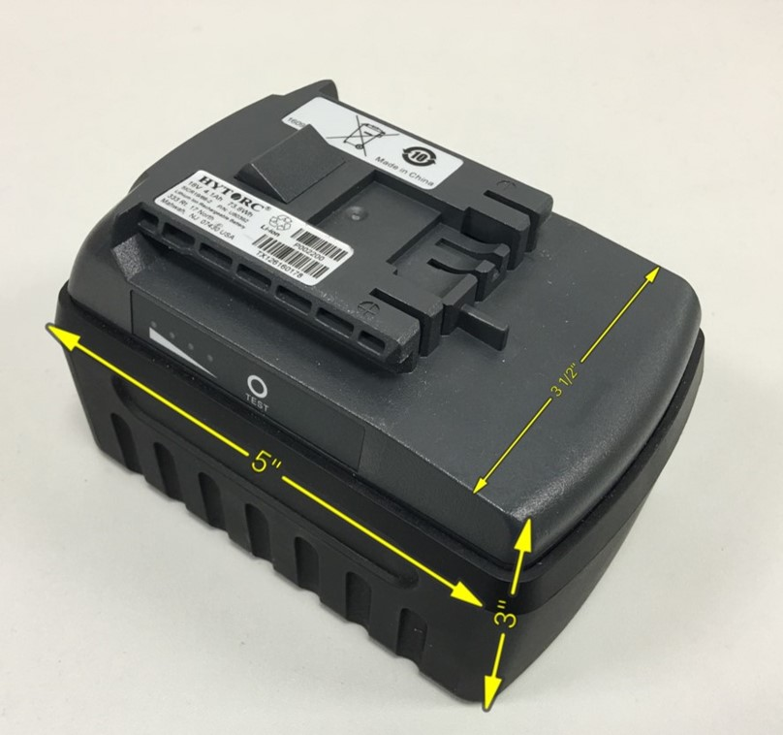
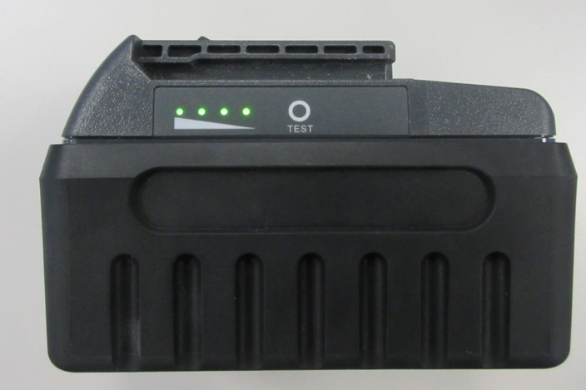
Test Battery
The operator can easily test the battery to verify the battery has a charge,
and estimate how much charge remains.
Push the TEST button on the side of the battery and the LED’s will provide an approximate indicator of remaining battery life:
1 LED On ≤ 25% Battery Charge Left
2 LEDs On ≤ 50% Battery Charge Left
3 LEDs On ≤ 75% Battery Charge Left
4 LEDs On ≤ 100% Battery Charge Left
Battery Weight 1.9lbs

Slide 21
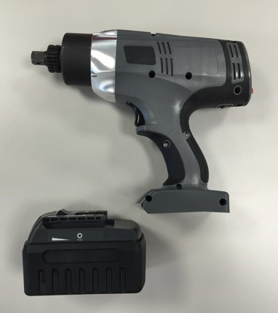
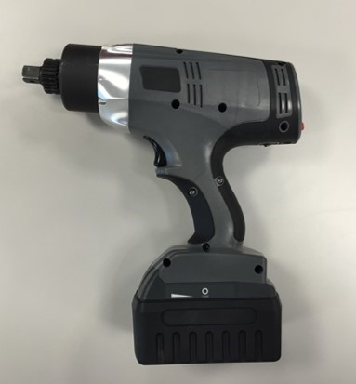
Install Battery
The battery easily slides onto the tool body and snaps into place.
Battery Installation
Press the release button on the battery and slide battery pack off the charger.
Align the base of the tool with the rails in the tool handle and slide the battery pack firmly into the handle until you hear (or see) the lock snap in place.
  Note: To remove the battery pack from the tool, press the release button on the battery and firmly pull the battery pack out of the tool.
Battery Operation
The 18-volt Lithium-Ion battery is designed for long running times with quick recharges and operates at full speed until depleted, so there is no gradual drop in power during use.
Batteries can be charged hundreds of times without any noticeable loss in capacity.
A typical charged battery can tighten hundreds of bolts (estimated 100-to-200 bolts), depending on the torque requirements.
For continuous use, workers will typically have one or more spare battery packs charging while the tool is in use and quickly swap batteries as they are drained.
HYTORC has partnered with the RBRC (Rechargeable Battery Recycling Corporation) in the US, and batteries can be returned at no charge for recycling at HYTORC service centers or local recycling centers.
Note: Check local and country guidelines for shipping LiON Guns with Lithium Ion batteries.
ON
OFF

Slide 22
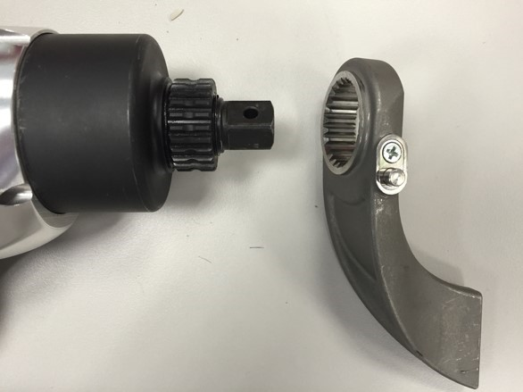
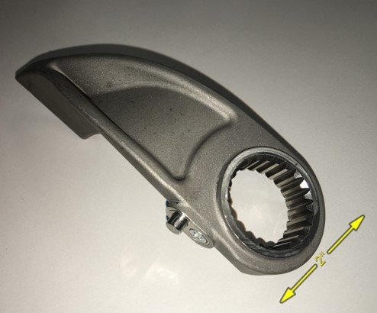
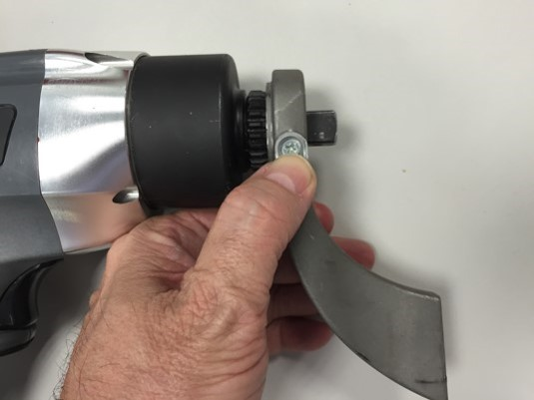
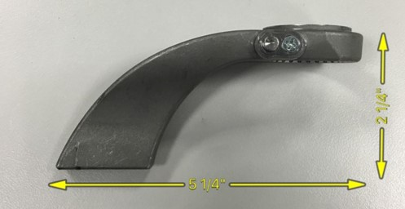
Install Reaction Arm
The push-button reaction arms is quickly and easily installed.
To install the reaction arm, gently depress the spring loaded push button on the reaction arm while sliding the reaction arm over the drive spline and release the button when the reaction arm is centered over the spline.
Challenge the reaction arm to make sure it is firmly secured onto the tool.
To remove the reaction arm, push the button on the reaction arm and slide off the spline.
NOTE: Modification to the reaction arm will result in loss of warranty for the tool. If you need a custom reaction arm, please consult with your local TORQUE GUN dealer.
Spring Loaded
Push button
    Caution: Never modify a reaction arm! Changes in the reaction arm may lead to personal injury or damage to the tool.

Slide 23
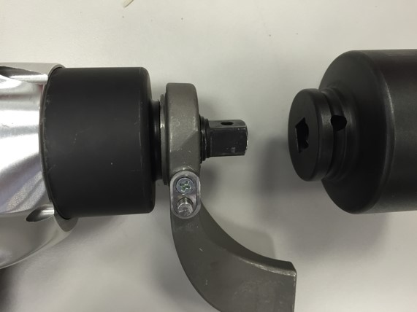
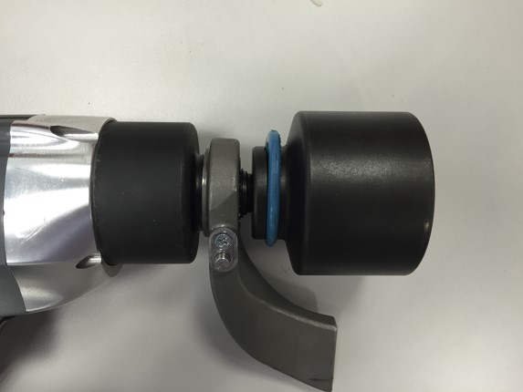
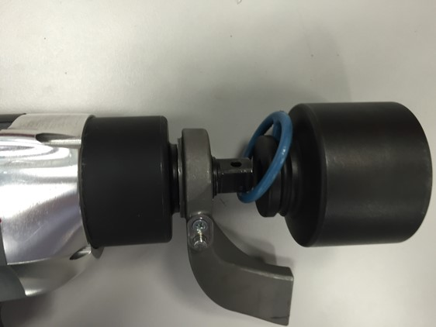
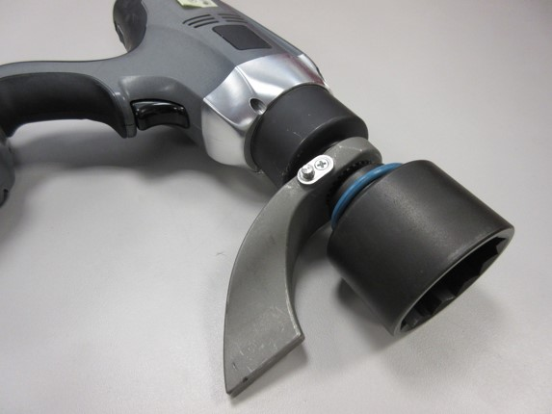
Install Socket
Standard square-drive sockets are easily installed and pinned to secure to the drive.
Align the pin hole in the socket with the hole in the square drive.
Make sure the O-ring is installed on the socket.
Slide socket on square drive while aligning the pin hole in the socket with the hole in the square drive.
Insert Pin through socket and square drive and seat the pin flush against the socket.
Slide O-ring in place to cover the pin and hold it in place.

Slide 24
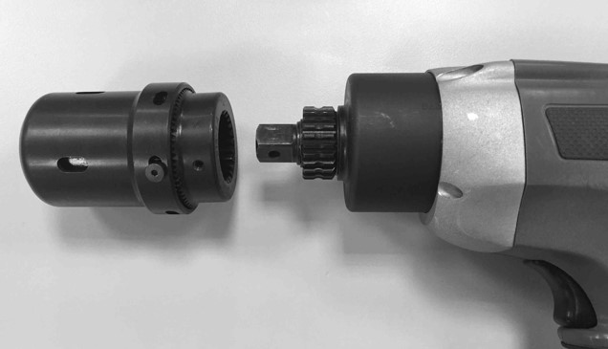

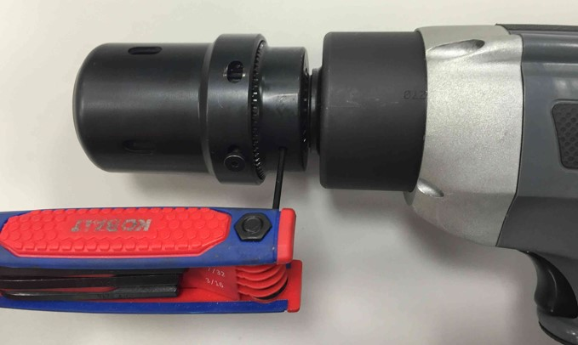
Install HYTORC Washer Driver
The HYTORC Washer Driver is easily installed with a Allen wrench.
Slide washer driver over the square drive and spline.
Tighten the washer driver set screw with an Allen wrench.
Challenge the washer driver to make sure it is securely attached to the spline.

Slide 25
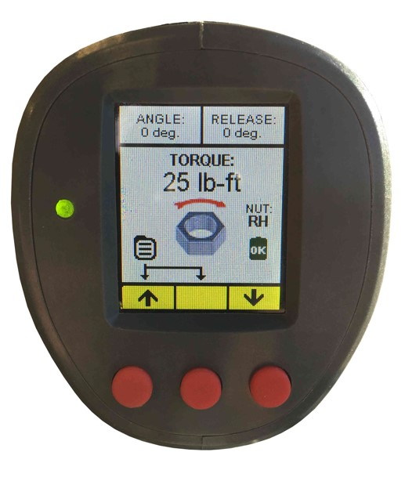
Power-On & Specify Settings
POWER ON: Push and release any of the 3 red buttons to power-up the tool.
The LiON tool settings are easily adjusted for specific job conditions.
Parameter | Default Setting | Range of Settings
Torque | 25 | 25 to 250 lb-ft *(subject to Min or Max Limit)
Output Units | lb-ft | lb-ft, N-m, kgf-m, %
Angle | 0 deg. | 0 to 360 degrees
Angle Delay (time) | 500 ms | 0 to 3000 milliseconds (Angle and Release)
Release | 0 deg. | 0 to 359 degrees
Fastener Type | RH (Right Hand) | RH (Right Hand), LH (Left Hand), HW (HYTORC WASHER), HN (HYTORC NUT)
Clock | Current Date, Eastern Time | Adjust for any time zone
Beeper | On | On or Off
Unlock Code | 0000 | 4 digit code – 0000 to 9999
Recording Mode | Stop | Start or Stop
Minimum Torque Limit | 25 lb-ft | 25-250 lb-ft
Maximum Torque Limit | 250 lb-ft | 25-250 lb-ft
Default Settings
(out of the box)
Tool powers off automatically after 5 minutes of “Trigger” inactivity in order to save battery charge.
When the tool is powered off, or the battery is removed, all settings are saved as a
Current Working Profile (CWP) and loaded automatically when the tool is powered back on.
Note 1: The CWP is not saved as a Saved Job Profile until the specific parameters are saved as a Job Profile under the Operations menu.
Note 2: the tool may be returned to default settings by adjusting each parameter – however this is usually not normally required

Slide 26
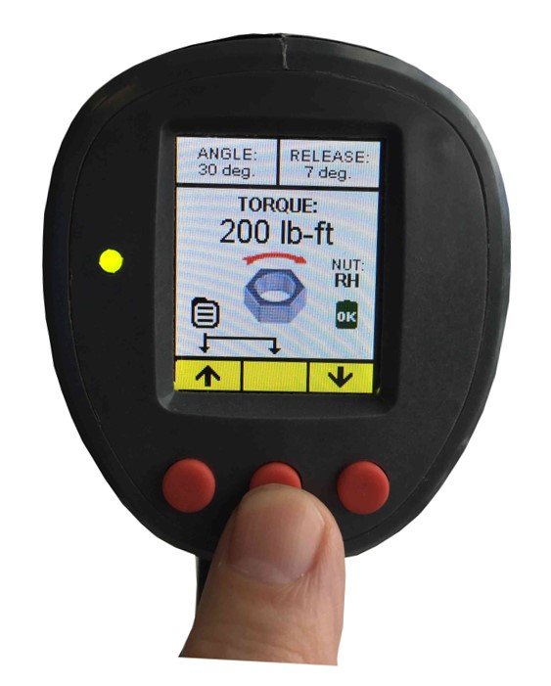
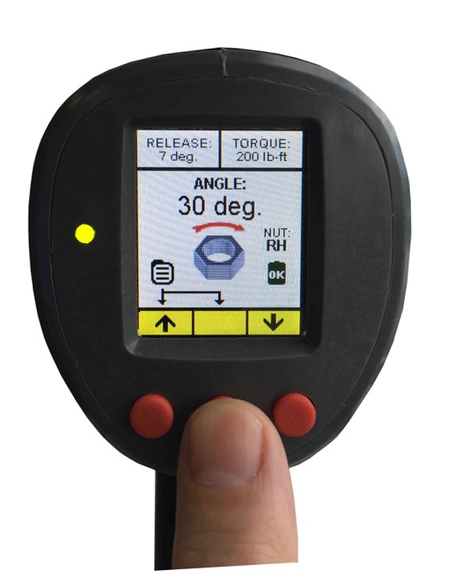
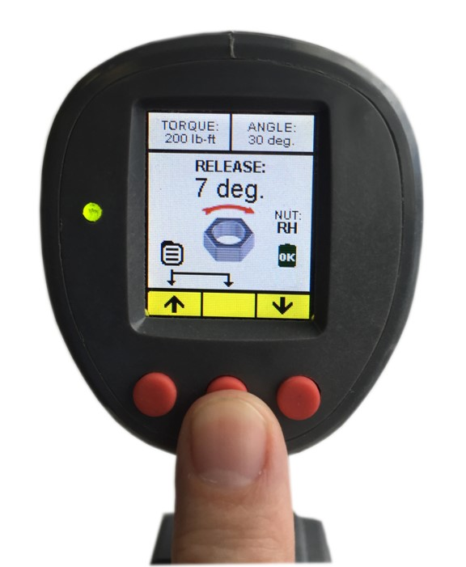
TORQUE, ANGLE and RELEASE Setup
Push and hold the center button for approximately 3-seconds and release
to scroll through the setup screens in the sequence of
TORQUE, ANGLE AND RELEASE.
TORQUE
ANGLE
RELEASE
①
②
③
Push
Hold 3s
Release
Push
Hold 3s
Release
Push
Hold 3s
Release

Slide 27
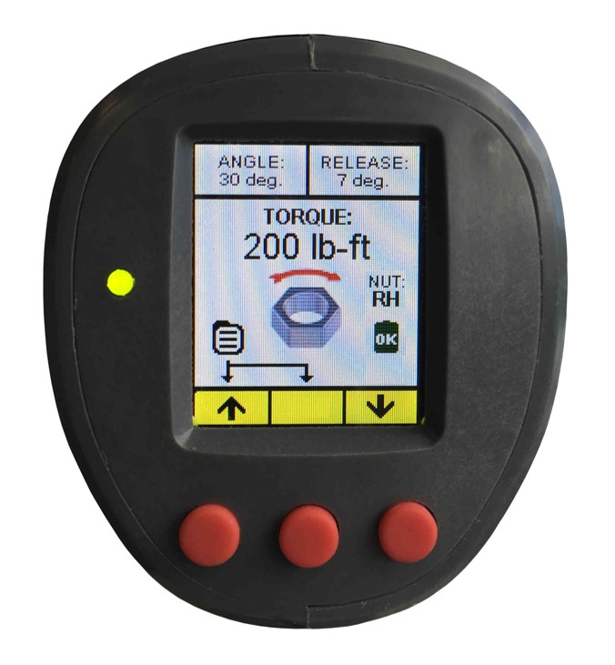
Set TORQUE
The Torque Value is set by simply pushing the left button ↑ to increase the torque or by pushing the right button ↓ to decrease the torque.
Torque may be set to any value from the minimum to the maximum capability of the tool (or MAX MIN Torque Limits set in the ADMIN menu).
Output units may be displayed in lb-ft, N-m, Kgf-m or %. (See output unit settings under the ADMIN menu)
The Torque rotational direction arrow and the rotating nut icon reflect the fastener clockwise or counter clockwise rotation associate with the specific fastener type. (the fastener type may be set under the Operation– Fastener Type menu ; Right-Hand, Left-Hand, HYTORC NUT and HYTORC Washer).
TORQUE set to 200 lb-ft.

Slide 28
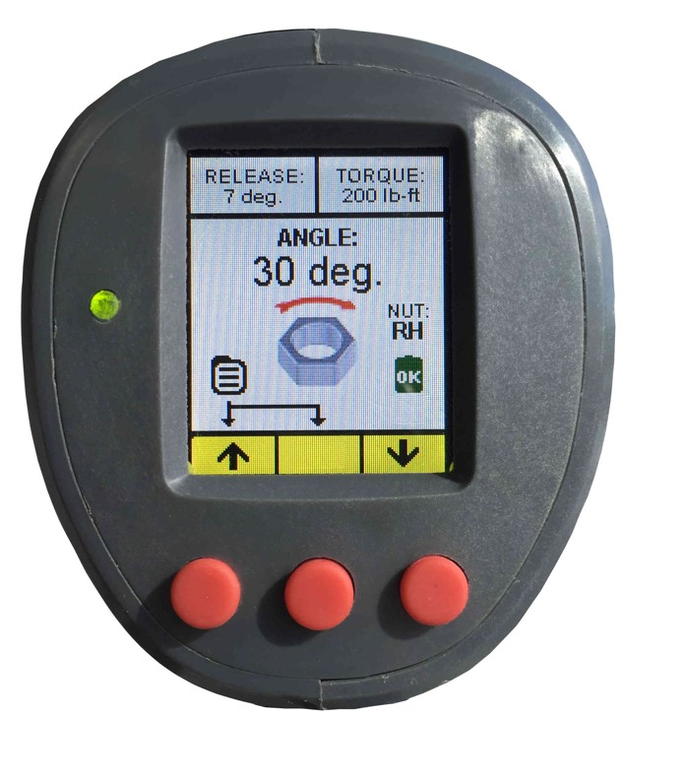
Set ANGLE
Certain bolt tightening specifications may require an Angle Value in-addition to or instead of a Torque Value.
The tool provides the ability to set an Angle value anywhere from 0 degrees to 360 degrees.
The Angle Value is increased simply by pushing the left button ↑ to increase the angle or by pushing the right button ↓ to decrease the angle.
If an Angle Value is set the gun will add the desired angle of rotation by applying additional torque after the completed torque operation up to the maximum output of the tool.
The angle feature is actuated by continuing to hold the trigger after the tool successfully completes the TORQUE.
The angle force is applied after a time delay set in the Angle Delay menu – typical ½ second to 3 seconds.
ANGLE set to 30 degrees.

Slide 29
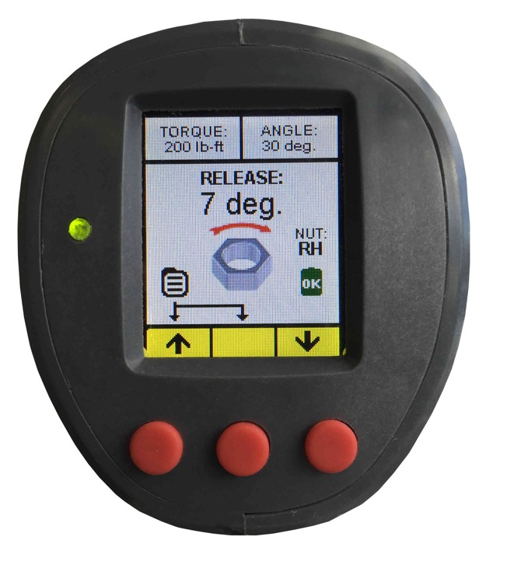
Set RELEASE
When the LiON tool achieves the TORQUE value (and ANGLE if set) the motor automatically stalls and the gear box continues to exert force (and reaction force) essentially locking the tool onto the nut.
The LiON gun provides a feature to release the tool from the nut by setting a RELEASE Angle to reverse the motor slightly thus taking the applied force off the gear box and reaction point and releasing the tool from the nut without loosening the nut.
The RELEASE Angle Setting may vary depending on the application and may need to be developed iteratively by testing the value on the application; the objective is to set the minimum RELEASE angle required to release the tool without applying a force in the opposite direction that would turn or loosen the nut.
While the tool has a capability to set the RELEASE between 0 and 359 degrees, the RELEASE is typically set on the lower end and less than 10 degrees (1-to-3 degrees for HYTORC Washer, or 3-to-7 degrees for reaction arms) so that nut is not loosened. Under certain conditions the operator may need higher RELEASE Angle settings and these should be verified to make sure that the nut is not being loosened by the higher setting.
The automatic release feature is actuated by continuing to hold the trigger after the tool successfully completes TORQUE(and ANGLE if set).
During the operation the screen will change to show the release angle and direction, the tool motor will reverse by the desired release angle and then stall again to allow the tool to be removed from the nut.
The RELEASE Angle is applied following application of TORQE (and ANGLE if set) and after an additional time delay set in the Angle Delay menu – typical ½ second to 3 seconds.
RELEASE set to 7 degrees.

Slide 30
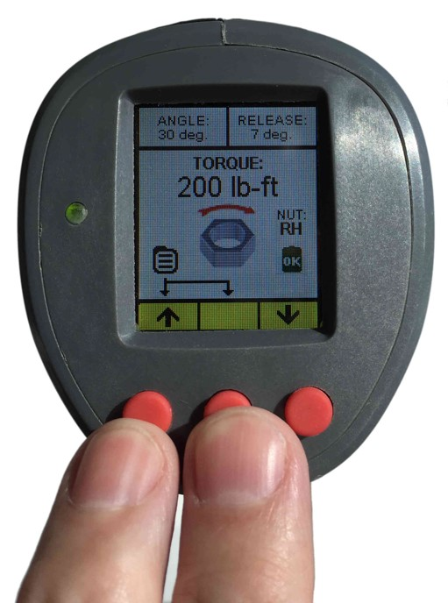
Access Main and Sub Menus
Main Menu
Press and hold left and center buttons simultaneously for approximately 3-seconds, release buttons when the “MAIN MENU” screen appears
MAIN MENU
OPERATION
JOB DATA
SYSTEM
ADMIN
EXIT MENU
POWER OFF
↓ | → | ↑
The green bar highlights the current position
Push left button to scroll down ↓, right button to scroll up ↑
Press the center button → to select and display a sub-menu
or to select EXIT MENU to return to Home Display
or to select POWER OFF DEVICE to shut off the power immediately
OPERATION
JOB PROFILES
FASTENER TYPE
OUTPUT UNITS
ANGLE DELAY
MAIN MENU
↓ | → | ↑
JOB DATA
JOB SELECT
DATA HISTORY
GENERATE CSV FILE
MAIN MENU
↓ | → | ↑
SYSTEM
SYSTEM INFO
DISPLAY ROTATION
BEEPER
DEBUG: CAL
DEBUG: TRIG
MAIN MENU
↓ | → | ↑
ADMIN
SET ADMIN CODE
SET LOCKOUT MODE
SET CLOCK
SET TORQUE LIMIT
CALIBRATE GUN
FORMAT NVRAM
MAIN MENU
↓ | → | ↑
Press and hold Left and Center Buttons Simultaneously to Display Main Menu

Slide 31
Operation
OPERATION
JOB PROFILES
FASTENER TYPE
OUTPUT UNITS
ANGLE DELAY
MAIN MENU
↓ | → | ↑
The Operation menu contains most functions
for every-day operation.
The green bar highlights the current position
Push left button to scroll down ↓, right button to scroll up ↑
Press the center button → to select and display a sub-menu
or select MAIN MENU to return to Main Menu.
ADMIN
ENTER
UNLOCK CODE
????
↑ | → | ↓
JOB PROFILES
1. T=25, A=0, R=7, RH
2. T=50, A=0. R=7, RH
3. T=100, A=0, R=7, RH
4. T=200, A=0, R=7, RH
5. T=50, A=0, R=7, HW
6. T=100, A=0, R=7, HW
7. T=200, A=0, R=7, HW
8. T=250, A=0, R=7, WH
↓ | → | ↑
MEMORY 0
↓ SAVE settings
Torque: 32
Angle: 30
Release: 7, HW
↑ LOAD settings
Torque: 250
Angle: 0
Release: 7, HW
↓ | X | ↑
FASTENER TYPE
RIGHT HAND
LEFT HAND
HYTORC NUT
HYTORC WASHERS
↓ | → | ↑
OUTPUT UNITS
ft-lbs
N-m
Kgf-m
%
↓ | → | ↑
CHANGE ANGLE DELAY
ENTER
ANGLE DELAY
500ms
↑ | → | ↓
In order to save or load a job profile the user must first enter the 4-digit code to unlock the tool. To enter the code press button ↑ to increase the digit or ↓ to decrease the digit, press → to advance to the next digit until the correct code is entered (default 0000). When the 4-digit code is entered correctly press → again to JOB PROFILES.
Allows the user to save tool parameters to memory as a Saved Job Profile (SJP), or to load previously saved parameters (SJPs) from memory. The tool can save up to 8 job profiles; each profile includes saved values for TORQUE (T), ANGLE (A), RELEASE (R) and fastener type. Scroll and select the desired setup values – then select →, or if saving new setup values select →, to access submenu to either SAVE or LOAD settings
The user can SAVE the settings currently on the home display – now shown in SAVE settings - by pushing the left button ↓ also adds the profile to the top of JOB PROFILES. Alternatively the user can LOAD the selected profile – now shown in LOAD settings - by pushing the right button ↑. Exit without load or save by hitting the center button X. Return to the OPERATION Menu upon completion.
Push appropriate button ↓↑ to scroll up or down, push → select fastener type:
RH RIGHT HAND bolts tightened clockwise.
LH LEFT HAND bolts tightened counterclockwise.
HN HYTORC NUT tightened counterclockwise.
HW HYTORC WASHER tightened clockwise.
Any selection → returns users to OPERATION menu.
Allows the operator to select the
preferred units of the torque display. Press buttons to scroll ↑ or ↓ to highlight the desired units , press → to select desired units and return to the OPERATION menu.
The user can adjust the time delay for applying the ANGLE and RELEASE following the TORQUE operation – the delay can range from 0ms to 3000ms. The time delay is applied after the TORQUE value by continuing to hold the trigger. Push up button ↑ to increase the delay or down button ↓ to decrease the delay. Select → to return to the OPERATION menu.

Slide 32
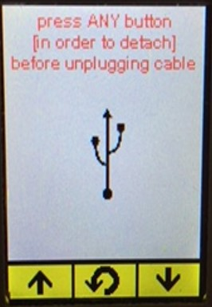
Job Data
JOB DATA
JOB SELECT
DATA HISTORY
GENERATE CSV FILE
MAIN MENU
↓ | → | ↑
The Data Recording menu contains settings needed
to record and download data from the tool.
The green bar highlights the current position
Push left button to scroll down ↓, right button to scroll up ↑
Press the center button → to select and display a sub-menu
or MAIN MENU to return to Main Menu
ADMIN
ENTER
UNLOCK CODE
????
NOTE: Wrong code returns user to previous screen. No limit on number of attempts.
See administrator for correct code.
↑ | → | ↓
JOB SELECT
JOB NUMBER
END JOBS
↑ | → | ↓
ENTER JOB
NUMBER
???
↑ | → | ↓
DATA HISTORY
jobs: 3
events: 479
current 114
10-22-2016
13.51.58
↑ | → | ↓
SELECT JOB NUMBER
JOB# EVENTS
N/A 00019
↑ | → | ↓
Connect USB cable to
Download. Press any
button before disconnecting
↓ | → | ↑
In order to record data the user must first enter the 4-digit UNLOCK CODE to unlock the tool. To enter the code press button ↑ to increase the digit or ↓ to decrease the digit, press → to advance to the next digit until the correct code is entered (default 0000). When the correct 4-digit code is entered press → again to proceed to SET RECORDING MODE.
User selects to turn Data Recording On “Start” or Off “Stop.” Press the buttons ↑↓ to scroll to START or STOP recording, press → to select RECORDING MODE and return to the DATA RECORDING menu.
When START Recording is selected, the user is asked to enter a 3 digit JOB NUMBER (000 to 999) for identifying the data record. To enter the job number press ↑ to increase the digit or ↓ to decrease the digit, press → to advance to the next digit until the code is entered. Press → to return to the DATA RECORDING menu. The tool is now in the RECORDING MODE and REC is displayed on the home screen.
Provides a summary of jobs and events currently being saved in memory.
Press the buttons ↑↓ to scroll through the job numbers to select the data set you want to download. Press → to select the job number and to generate the CSV file.
The CSV file will be accessible through a standard USB cable connected between the PC (Type A) to the tool (Micro A). The tool is discovered by the PC just as any mass storage device. When done, press → button to exit the GENERATE CSV FILE mode and return to the DATA RECORDING menu. The PC will discover the file and the user can open the file in Excel (default) or text format.

Slide 33


Job Data
Recording Indicator
When the RECORDING mode is started, the Home Display provides a display of JOB ON
and the
Job Number
Connect Standard USB Cable
After the CSV file has been generated, the USB cable is connected and the tool is powered ON the LiON gun will automatically be discovered by the PC just as any other other storage device.
If the PC has Excel the CSV file will appear on the PC in Excel format by default and can be opened or saved.
USB Type A
Plug
USB
Micro A
Plug
Sample CSV file in Excel (default).

Slide 34
System
SYSTEM
SYSTEM INFO
DISPLAY ROTATION
BEEPER
DEBUG: CAL*
DEBUG: TRIG*
MAIN MENU
↓ | → | ↑
The System menu contains additional settings
for tool configuration.
The green bar highlights the current position
Push left button to scroll down ↓, right button to scroll up ↑
Press the center button → to select and display a sub-menu
or select MAIN MENU to return to Main Menu
* NOTE: DEBUG:CAL and DEBUG:TRIG are not intended for field use. These functions are password protected and only accessible by HYTORC in the factory.
SYSTEM INFO
MDC FW ref: 1.00
MDC HW rev: 1.00
UIC FW rev: 1.00 A
UIC WH rev: 1.00
X | X | X
DISPLAY ROTATION
NORMAL
INVERT
INVERT FOR CAL.
↓ | → | ↑
BEEPER
OFF
ON
↓ | → | ↑
Displays Firmware (FW) and Hardware (HW) versions for MDC (Motor Drive Control) And UIC (User Interface Control). Press any button to return to SYSTEM menu.
Provides capability to orient the display in normal or inverted mode:
NORMAL Screen is legible when battery is down.
INVERT Screen is legible when battery is up.
INVERT FOR CAL Inverted for calibration
Scroll down ↓ or scroll up ↑ to reach desired orientation for the display and push → to select the orientation and return to the SYSTEM SETTINGS menu
The user can optionally enable or disable the beeper. Press buttons to scroll ↑ or ↓ to highlight the desired state for the beeper, press → to select beep OFF or ON and return to the ADMIN menu. If turned on the beeper will sound 1 time for each successful operation and 4 times to indicate an error.

Slide 35
Admin
ADMIN
SET ADMIN CODE
SET LOCKOUT MODE
SET CLOCK
SET TORQUE LIMIT
CALIBRATE GUN
FORMAT NVRAM*
MAIN MENU
↓ | → | ↑
The Admin menu contains less seldom used features or those
typically only configured by an administrator or supervisor.
The green bar highlights the current position
Push left button to scroll down ↓, right button to scroll up ↑
Press the center button → to select and display a sub-menu
or select MAIN MENU to return to Main Menu
* NOTE: FORMAT NVRAM is not intended for field use. This functions is password protected and only accessible by HYTORC in the factory.
Sub Menus Continued
Next Page
ADMIN
ENTER
UNLOCK CODE
????
NOTE: Wrong code returns
user to previous screen.
No limit on number of attempts.
See administrator for correct code.
↑ | → | ↓
CHANGE UNLOCK CODE
ENTER NEW
UNLOCK CODE
????
↑ | → | ↓
SET LOCKOUT MODE
ENABLE
DISABLE
↓ | → | ↑
SET CLOCK
TIME:
12: 53: 00
DATE:
12/22/2016
↑ | → | ↓
TORQUE LIMIT
ENTER MINIMUM
TORQUE SETTING
25 lb-ft
↑ | → | ↓
TORQUE LIMIT
ENTER MAXIMUM
TORQUE SETTING
250 lb-ft
↑ | → | ↓
User must first enter the 4 digit unlock code for access to admin features. The default code is 0000. To enter the unlock code press ↑↓ buttons to change the digits in each position to match the code - press → to advance to the next digit. When all digits match the code press → to display ADMIN menu – all functions in the menu are now available.
Allows the user to change the 4 digit unlock code required for access to features. Enter the new 4 digit code by pressing the ↑↓ to set a new digit in each position, press → to advance to the next to position. Once the entire NEW CODE has been entered, press → to go to the ADMIN screen, make a note of the NEW CODE
The user may enable a lockout mode that prevents any user from changing any parameter except directional control. This allows the administrator to lock the tool at desired settings for various users. Press the buttons ↑↓ to scroll to ENABLE or DISABLE lockout mode, press → to select LOCKOUT MODE and return to the ADMIN menu
Allows user to set time and date by entering appropriate numerical values.
Push up button ↑ increases the value and down button ↓ to decrease the value, select → to advance to the next numerical value, after setting year push → to return to SYSTEMS SETTINGS menu
To adjust the minimum TORQUE limit press button ↑ to increase the value or ↓ to decrease the value.
Press → to save the lower torque limit – screen flashes “Saving setting” and then displays the upper torque limit screen.
To adjust the maximum TORQUE limit press button ↑ to increase the value or ↓ to decrease the value.
Press → to save the upper torque limit – screen flashes “Saving setting” and then exits to ADMIN menu.

Slide 36
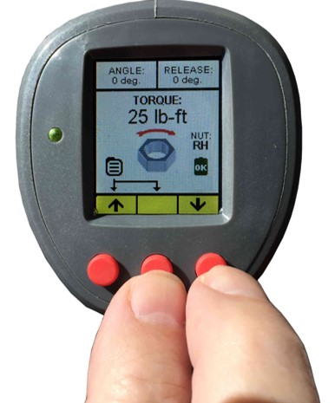

Admin - Calibration
Each LiON Battery Gun is Calibrated with Torque Calibration Equipment
in the Factory before shipment.
The Calibration menu may be reached by selecting CALIBRATE GUN in the ADMIN menu
Recalibration is recommended at least once a year, or more often for higher use or when changing fastener types.
Note: Calibration is usually done with the RH fastener selected for consistency.
Calibration should only be done by qualified personnel according to HYTORC process.
CALIBRATION
CAL POINT 1-10
OPERATE GUN &
RECORD TORQUE
R
X |  | X
CALIBRATION
ENTER MEASURED
TORQUE
xxx
↑ | → | ↓
CALIBRATION
↓ SAVE
CALIBRATION
↑ CANCEL CALIBRATION
↑ | → | ↓
Calibration Equipment
If you enter this menu and don’t want to calibrate, hit the X to exit.
Shortcut: The Calibration menu may also be accessed with a Shortcut - Press and hold Right and Center Buttons approximately 3-seconds and release to display the Calibration Menu.
Note if the Unlock code has not been entered yet in the session, the operator will be presented with the ADMIN screen and asked for the unlock code before directing them to the Calibration menu.
The Tool is installed in the Calibration Equipment which is set at a known torque calibration point. The “R” on the tool screen is for Right Hand Calibration. (Note the center button is not active in this menu). The tool is operated in the calibration fixture until it stalls at the calibration point. When the tool stalls the calibration equipment provides a measured Torque value. The tool displays the next menu prompting the operator to enter the measured value. If the user does no want to calibration press the left or right button X to exit and the Calibration sequence is canceled.
The Torque value measured by the calibration equipment is entered into the tool. To enter the value press left or right ↑↓ buttons to change the digits in each position to match the measured value - press → to advance to the next digit. Press → again after the last digit to return to the previous menu and run the tool at the next calibration point in the sequence. This procedure is repeated for all calibration points (typically 1 to 10) allowing the measured value to be entered into the tool at each calibration point.
Following entry of the last (maximum) calibration point a menu appears to allow the calibration values to be saved in the tool. Select SAVE to complete the calibration process or CANCEL to return to the ADMIN menu.
Note: Following the calibration process the tool is again tested against known calibration values to ensure accuracy ±5%. A calibration sticker is affixed to the tool providing date of calibration and due date for next calibration.
Calibration Equipment

Slide 37


Tighten Bolt
If the tool is set for RH or LH fasteners and the trigger is pulled, a message is displayed to instruct the operator to “Press any button to start operation.” This forces the operator to continue holding the trigger while moving the second hand to the rear of the tool to push a button to start, to ensure that both hands are clear of the reaction area.
Configure the tool with appropriate socket and reaction arm if used.
Power on the tool and set TORQUE, ANGLE and RELEASE and Fastener Type.
Complete any other setup functions; e.g. start Data Recording before beginning the operation.
If needed, apply a back wrench to the back nut on the bolt.
Place the tool socket on the nut, making sure that the socket has fully engaged the nut.
If a reaction arm is used, make sure the reaction arm is firmly abutted against a stationary object (e.g. an adjacent nut, flange, equipment housing etc.
Pull the trigger to start the operation cycle.
  Note: If RH or LH fasteners are selected the tool will not operate until the user simultaneously pushes the trigger and any button on the rear of the tool – this is a safety feature to ensure that hands are clear of the reaction arm. If the reaction arm is has not already been positioned against a firm surface, once the tool starts the reaction arm will move until it is firmly abutted against the reaction surface.
Continue holding the trigger and the tool will torque and rotate the nut until it stalls at the specified TORQUE value.
Continue holding the trigger if an ANGLE has been specified and the tool will restart (after completing the specified TORQUE and time delay) and then stall again after rotating the nut through the specified ANGLE.
Continue holding the trigger if a RELEASE has been specified and the tool will restart (after completing the specified TORQUE, ANGLE and time delays) and then stall again after completing the reverse RELEASE angle to allow the tool to be released from the nut.
Release the trigger only after the tool has completed all specified operations and stalls, and then remove the tool and socket from the nut.
The status light is amber during operation, if the operation is successful status light will illuminate green, if unsuccessful the status light will turn red.
For RH and LH fastener, the operator must pull trigger and press button simultaneously to begin operation.

Slide 38
Loosen Bolt
Use the menu to specify the type of fastener being used.
Use the directional switch to make sure the tool to is set to loosen the fastener.
Make sure the tool is positioned properly on the nut.
If needed, install back wrench or apply back wrench fixture to the back nut.
If a reaction arm is used, make sure the reaction arm is firmly abutted against a stationary object (e.g. an adjacent nut, flange, equipment housing etc.
Pull the trigger to start the loosening operation, nut will continue to turn.
Release the trigger to stop loosening the fastener to verify that the bolt is completely loose.
The status light is green in the loosen mode, once the trigger is pulled the status light turns amber and stays amber through the operation, a status light turning red indicates an error.

Slide 39
LiON Gun Safety
BOSS Training Series
Basic Operation and Safety School

Slide 40
General Safety
Keep Work Area Clean – Keep the bolting work area clean, organized and well lit reduces the change of accidents.
Don’t Operate in Explosive Atmospheres - The Battery Gun is not certified for explosive environments – potentially could ignite the dusts or fumes. Do not operate the presence of flammable liquids, gases or dusts.
Avoid Distractions - Keep bystanders away while operating the Battery Gun to avoid distractions and loss of control.
Avoid Pinch Points - If using reaction arms, select reaction surfaces that avoid pinch points to avoid hand injury.
React In-Line - Select reaction points in-line with the nut and make sure the tool drive and socket axis are aligned with the axis of the bolt – avoid bending or side-load on the or bolt.
React Against a Solid Surface - Select the reaction surface so that the reaction arm firmly abuts against the surface to enhance work safety and longer tool life.
Review Socket Safety – Review socket safety criteria, make sure to use only impact grade sockets that are free from defect or modification.

Slide 41

Personal Safety
  Wear PPE – Wear Personal Protective Equipment (PPE) when operating a LiON Gun including gloves, eye protection, hard hat, safety shoes and hearing protection.
  Stay Alert - Watch what you are doing and do not use the Battery Gun while you are tired or under the influence of drugs, alcohol, or medication.
  Avoid Unintentional Use – Do not hold your finger against the trigger while carrying the tool or when installing the battery to avoid unintentional use.
Secure Rotating Parts or Tools – Make sure all rotating parts are firmly affixed to the drive and remove any keys, wrenches or loose-parts before turning on the tool.
Do Not Lean-In or Overreach - Keep proper footing and balance at all times to keep hands away from pinch points and to better control the tool in all situations.
Avoid Loose Fitting Clothing - Do not wear loose clothing or jewelry and keep your hair, clothing, jewelry and gloves away from the moving parts.
Dust Extraction - If devices are provided for the connection of dust extraction ensure these are connected and properly used to reduce dust-related hazards.
PPE
Personal Protective Equipment

Slide 42
Battery Gun Safety
Keep Vents Clean – Battery Gun side vents should be free of debris to prevent overheating/fire.
Use the Correct Tool for the Job - The LiON Battery Gun will do the job better and safer when used for the applications and working conditions for which it was designed.
Verify Power Control - Do not use the LiON Battery Gun that cannot be powered on/off; this condition is dangerous and must be repaired.
Remove Battery Pack Before Configuration – Remove the battery pack from the Battery Gun before making any adjustments, adding accessories, changing configurations or before storing the tool to reduce the risk of inadvertently powering on the Battery Gun.
Untrained Operators - Do not allow persons unfamiliar with the Battery Gun or these instructions to operate the Battery Gun; keep the tool out of the reach of children.
Maintain Battery Guns - Check the misalignment or binding of moving parts, breakage of parts and any other condition that may affect the power of tool’s operation. If damaged, have the Battery Gun repaired before use.

Slide 43

Battery Pack Safety
WARNING: Burn hazard, battery content is extremely combustive.
  Fire may occur if the battery terminals inadvertently come in contact with conductive materials.
  Battery contents may be flammable if exposed to spark or flame.
  Do not incinerate the battery pack, it can burn/explode in a fire emitting toxic fumes.
  Do not charge or use the battery pack in an explosive atmosphere or in the presence of flammable liquids, gases or dust.
  Inserting or removing the battery from the charger may ignite dust or fumes.
WARNING: Exposure Hazard, exposure to battery content may be toxic.
  Never attempt to open the battery pack for any reason.
  Do not use a battery pack that has been damaged, cracked or dropped
  If contents contact with the skin, immediately wash area with mild soap and water.
  If battery content gets into the eyes, rinse eye for 15 minutes or until irritation ceases.
  Contents may cause respiratory irritation, provide fresh air and seek medical help.
  The battery electrolyte is composed of a mixture of liquid organic carbonates and lithium salts.
ONLY charge the battery in battery chargers supplied with the product.
DO NOT splash or immerse the battery pack in water or other liquids.
DO NOT store or use the battery pack where temperatures may exceed 150F (65C).
.
Avoid metallic contact
with battery terminals

Slide 44

Battery Charger Safety
WARNING: Shock hazard. Do not allow any liquid to get inside charger, avoid rain or snow.
WARNING: Burn Hazard. Only charge the LiON batteries in the charger provided.
  Charging other types of batteries may risk fire, shock or may burst causing personal injury and damage.
WARNING: Fire Hazard. When plugged in the charger can be shorted by foreign material.
  Keep conductive materials away from charger cavities.
  Always unplug the charger from the power supply when there is no battery pack in the cavity or cleaning.
WARNING: Make sure the charging cord will not be stepped on or damaged.
  Do not operate a charger with damaged cord or plug. Have any damaged plug or cord replaced immediately.
Do not use an extension cord unless it is absolutely necessary.
  An extension cord must have adequate wire size (AWG) for safety.
Do not block any ventilation slots on charger power supply.
The charger is intended to be used on a flat surface (i.e. table top, bench top).
  Do not mount charger on wall or permanently fix charger to any surface.
Do not drop the charger
  Do not operate charger if it has received a sharp blow, been dropped, or otherwise damaged in any way.
Do not attempt to disassemble or repair charger.
Take the charger to an authorized service center when service or repair is required.

Slide 45
Lets Bolt!
333 Route 17 North, Mahwah, NJ 07430
1-800-FOR-HYTORC | www.hytorc.com
BOSS Training Series
Basic Operation and Safety School

